Slide 1
Ch-12 MiniMax Search Procedure

Slide 2
The MiniMax Search Procedure
The minimax Search Procedure is a depth-first, depth-limited search procedure.
The idea is to start at the current position and use the plausible-move generator to generate the set of possible successor positions.
Now we can apply the static evaluation function to those positions and simply choose the best one.
After doing so, we can back that value up to the starting position to represent our evaluation of it .
The starting position is exactly as good for us as the position generated by the best move we can make next.

Slide 3
The MiniMax Search Procedure
We assume that the static evaluation function returns large values to indicate good situations for us, so our goal is to maximize the value of the static evaluation function of the next board position.
It assumes a static evaluation function that returns values ranging from -10 to 10, 10 indicating a win for us ,-10 a win for the opponent, and 0 an even match.

Slide 4
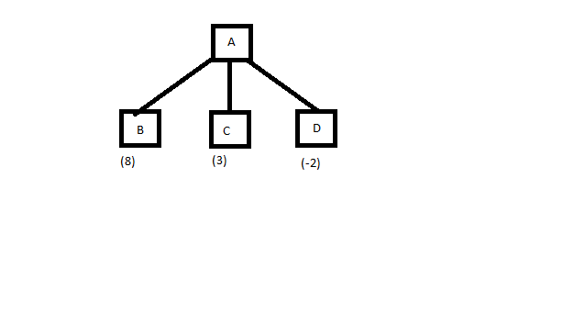
Example

Slide 5
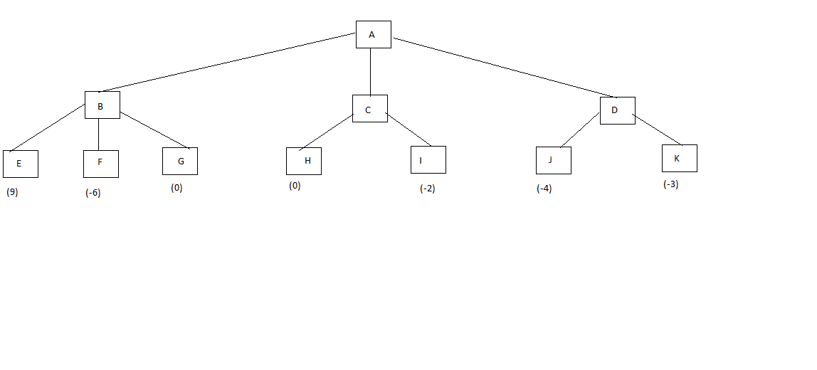
Example

Slide 6
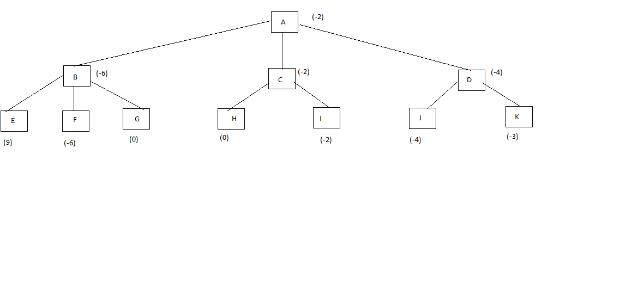
Example

Slide 7
Definition
The alteration of maximizing and minimizing at alternate ply when evaluations are being pushed back up corresponds to the opposing strategies of the two players and give this method the minimax

Slide 8
Algorithm
MOVEGEN( Position, Player)- the plausible move generator, which returns a list of nodes representing the moves that can be made by player in position.
STATIC ( Position, Player)- The static evaluation function, which returns a number representing the goodness of Position from the standpoint of Player .
AS with any recursive program, a critical issue in the design of the MINIMAX procedure is when to stop the recursion and simply call the static evaluation function. There are a variety that may influence this decision. They include:

Slide 9
Algorithm
Has one side won?
How many ply have we already explored?
How promising is this path?
How much time is left?
How stable is the configuration?
DEEP-ENOUGH:- function which is assumed to evaluate all of these factors and to return TRUE if the search should be stopped at the current level and FALSE otherwise.
Take two parameters, Position and Depth.
It will ignore its Position parameter and simply return TRUE if its Depth parameter exceeds a constant cutoff value.

Slide 10
Algorithm
One problem arises in defining MINIMAX as a recursive procedure is that it needs to return not one but two results:
The backed-up value of the path it chooses.
The path itself. We return the entire path even though probably only the first element, representing the best move from the current position, is actually needed.
Two functions VALUE and PATH, that extract the separate components.
MINIMAX functions take three parameters, a board position, the current depth of the search, and the player to move.
CURRENT= MINIMAX(Current,0, Player-one)

Slide 11
Algorithm
If DEEP-ENOUGH(Position, Depth), then return the structure
VALUE=STATIC(Position, Player); PATH=nil.
2.Otherwise, generate one more ply of the tree by calling the function MOVEGEN(Position, Player) and setting SUCCESSORS to the list it returns.
3. If SUCCESSORS is empty, then there are no moves to be made, so return the same structure that would have been returned if DEEP-ENOUGH had returned true.

Slide 12
Algorithm
4. If SUCCESSORS is not empty, then examine each element in turn and keep track of the best one. This is done as follows.
Initialize BEST-SCORE to the minimum value that STATIC can return. It will be updated to reflect the best score that can be achieved by an element of SUCCESSORS.
For each element SUCC of SUCCESSORS, do the following:
Set RESULT-SUCC to MINIMAX(SUCC, Depth+1, OPPOSITE(Player))( will actually carry out the exploration of SUCC)

Slide 13
Algorithm
(b) Set NEW-VALUE to –VALUE(RESULT-SUCC)(this will cause it to reflect the merits of the position from the opposite perspective from that of the next lower level)
( c) If NEW-VALUE>BEST-SCORE, then we have found a successor that is better than any that have been examined so far. Record this and do the following:
Set BEST-SCORE to NEW-VALUE
The best known path is now from CURRENT to SUCC and then on to the appropriate path down from SUCC as determined by the recursive call to MINIMAX. So the BEST_PATH to the result of attaching SUCC to the front of PATH(RESULT-SUCC)

Slide 14
Algorithm
5. Now that all the successors have been examined , we know the value of Position as well as which path to take it from. So return the structure
VALUE=BEST-SCORE
PATH=BEST-PATH

Slide 15
Adding Alpha-Beta Cutoffs
Alpha–beta pruning is a search algorithm that seeks to decrease the number of nodes that are evaluated by the minimax algorithm in its search tree.
It is an adversarial search algorithm used commonly for machine playing of two-player games (Tic-tac-toe, Chess, Go, etc.).
It stops completely evaluating a move when at least one possibility has been found that proves the move to be worse than a previously examined move. Such moves need not be evaluated further. When applied to a standard minimax tree, it returns the same move as minimax would, but prunes away branches that cannot possibly influence the final decision.
“a technique that improves upon the minimax algorithm by ignoring branches on the game tree that do not contribute further to the outcome. “

Slide 16
Adding Alpha-Beta Cutoffs
One of the good things about the depth-first procedures is that their efficiency can often be improved by using branch and bound techniques.
This modified strategy is alpha-beta pruning.
It requires the maintenance of two threshold values, one representing a lower bound on the value that a maximizing node may ultimately be assigned (alpha) and another representing an upper bound on the value that a minimizing node may be assigned(beta)

Slide 17
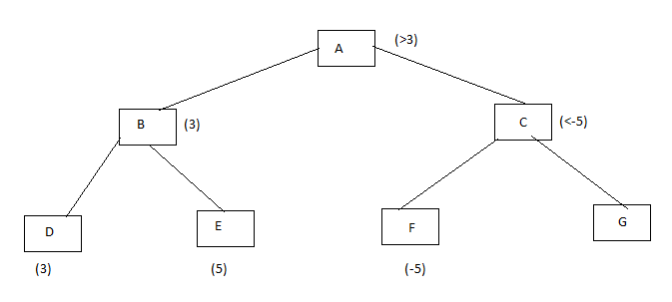
Example

Slide 18
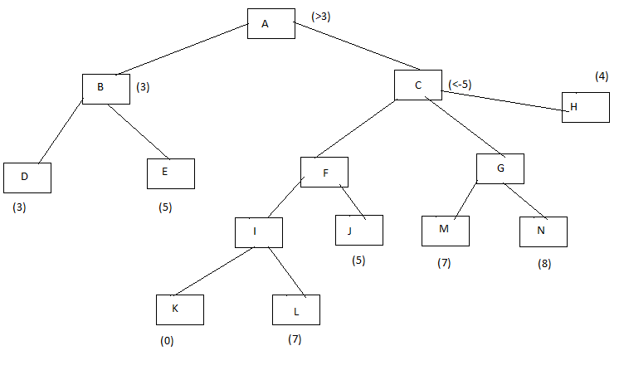
Example

